Slide 1

Data Visualization (Plotting)

Slide 2
Bar plot
Histogram
Scatter plot
Heat map
Line plot
Violin plot
Area chart
Pie chart
Box plot
Tree map
Pivot table

Slide 3
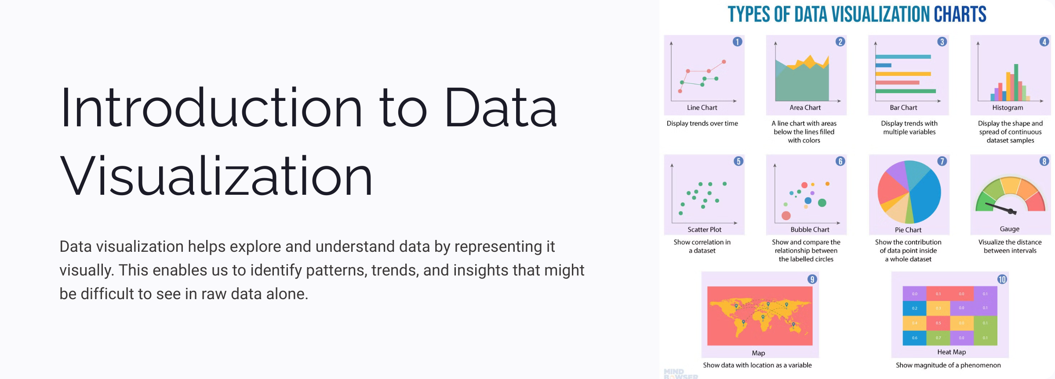

Slide 4
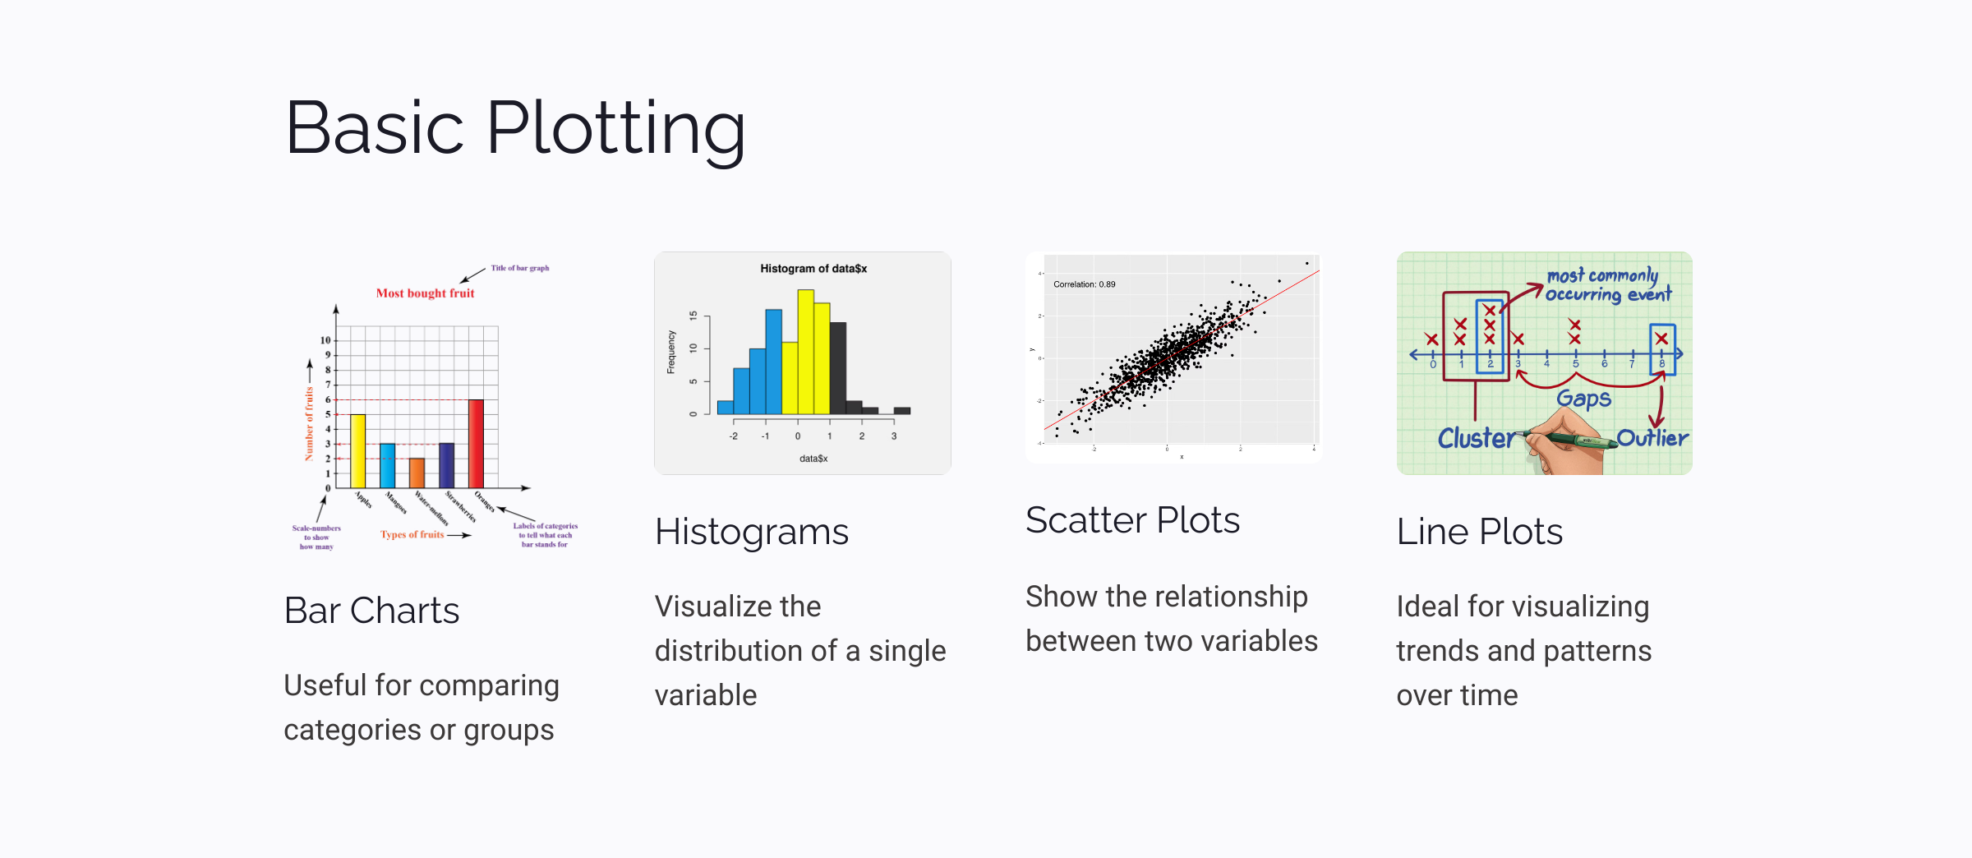

Slide 5
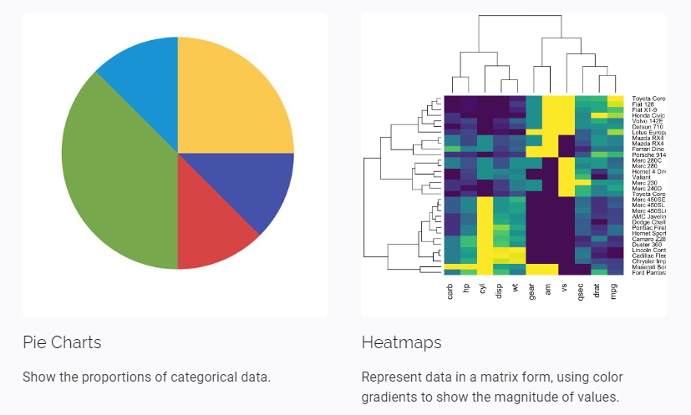

Slide 6
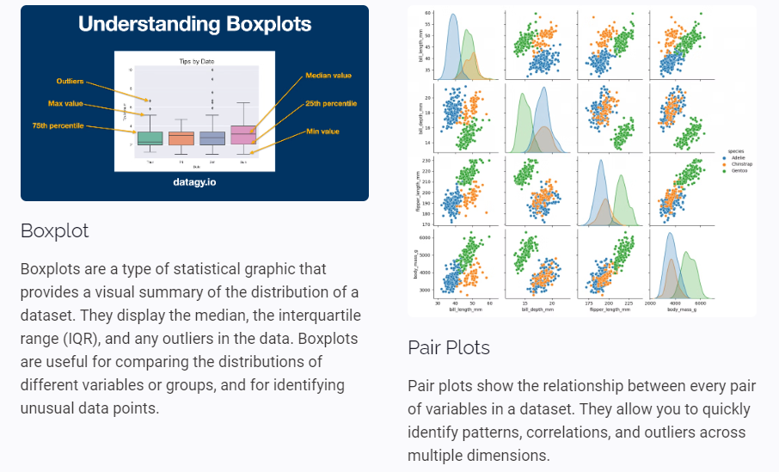

Slide 7
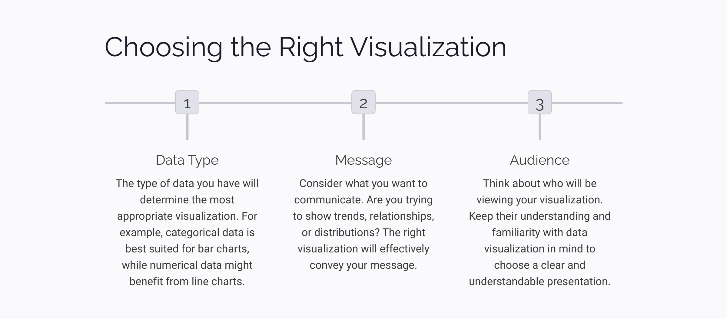

Slide 8
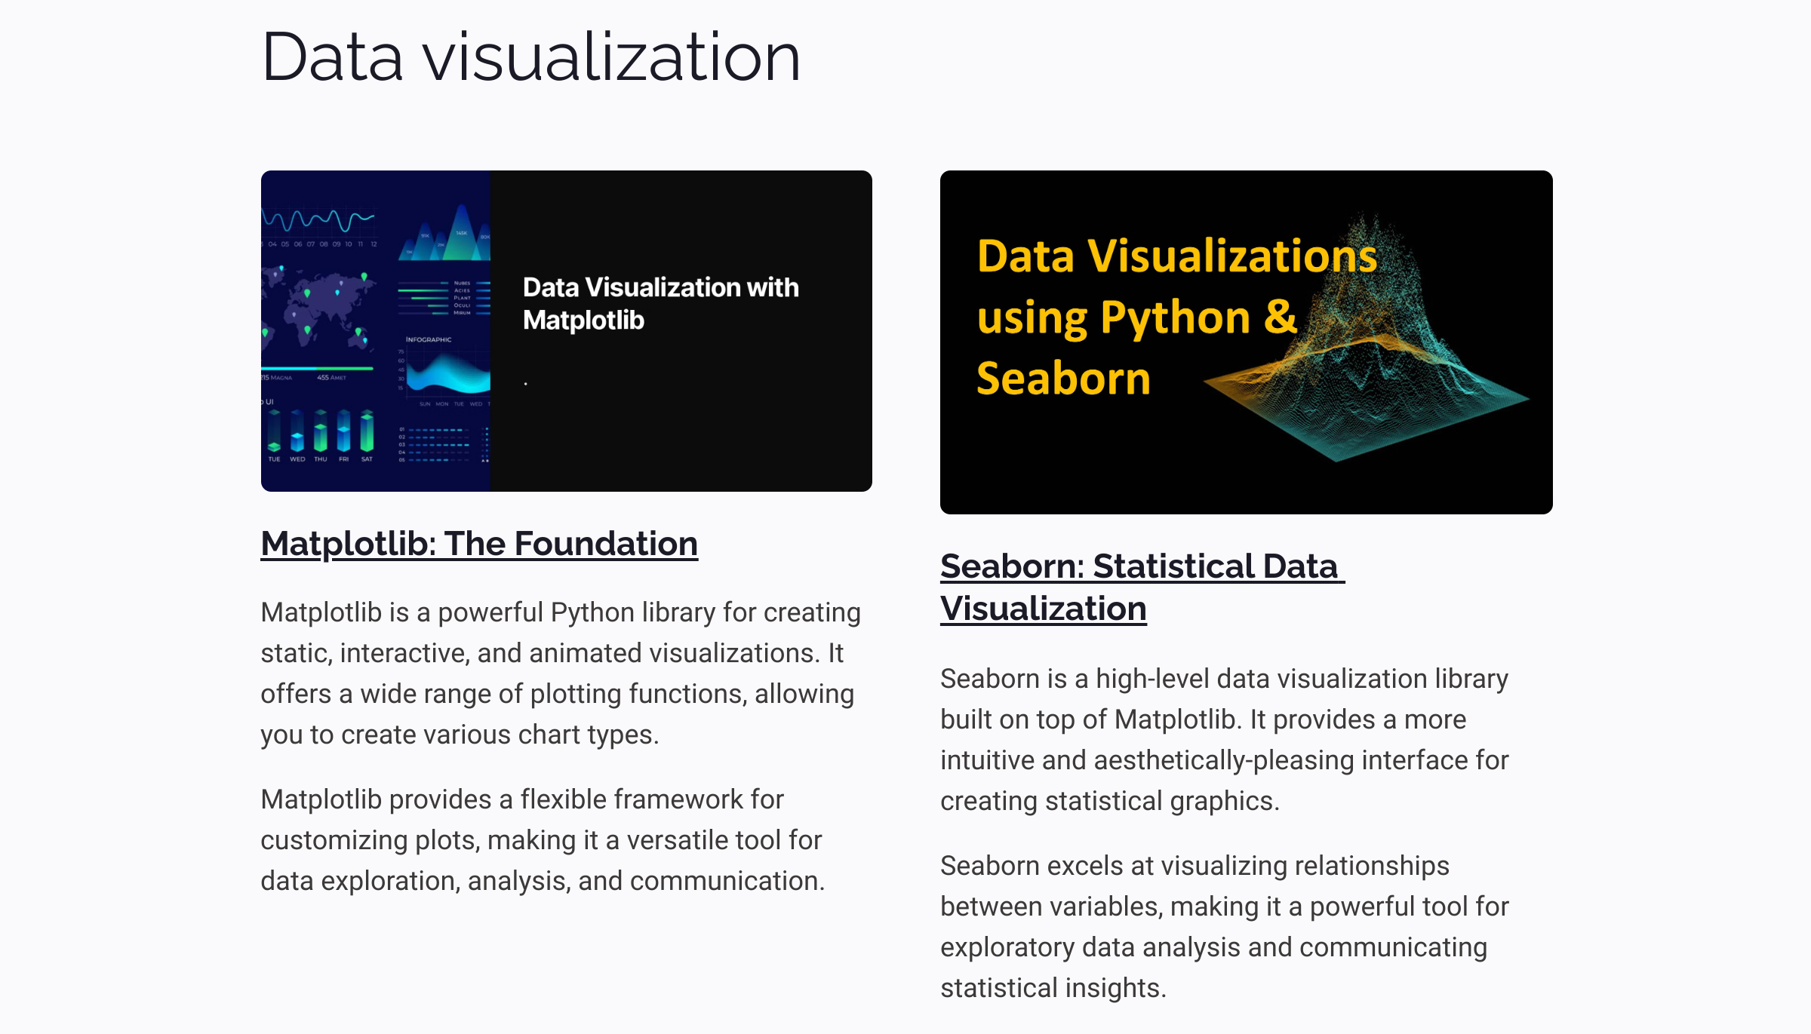

Slide 9
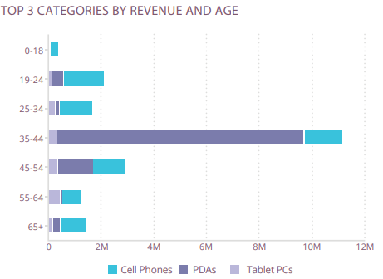
Bar Plot
What is It?
A bar plot is a visual representation of categorical data using rectangular bars,
where the height of each bar corresponds to the value It is commonly used for
comparing and summarizing data.
What Does It Visualize?
Bar charts are more commonly used to compare different values,
items and categories of data. A bar plot visualizes categorical data by using bars
to represent the values or frequencies of different categories
What Does It Measure?
A bar plot measures the magnitude by using the height or length of the bars to represent the values or quantities associated with each category. It helps to identify patterns, comparisons, or trends within the data.
What Sources of Data Does It Use?
A bar plot can use various sources of data, including survey responses, sales figures, population statistics, or any other data that can be categorized into distinct groups.

Slide 10
Histogram
What is It?
A histogram plot is a graphical representation of the distribution of a continuous variable, where the data is divided into bins or intervals, and the height of each bar represents the frequency or count of data points within that bin.
What Does It Visualize?
A histogram plot visualizes the distribution or frequency of values in a dataset, allowing for analysis of patterns, central tendency, and outliers in the data. It provides insights into the shape and spread of the variable being plotted.
What Does It Measure?
A histogram measures the frequency or count of data points within each bin or interval, providing information about the distribution and density of values in a dataset.
What Sources of Data Does It Use?
A histogram can be created using any source of data that provides numerical or continuous values, such as measurements, survey responses, or experimental results.

Slide 11
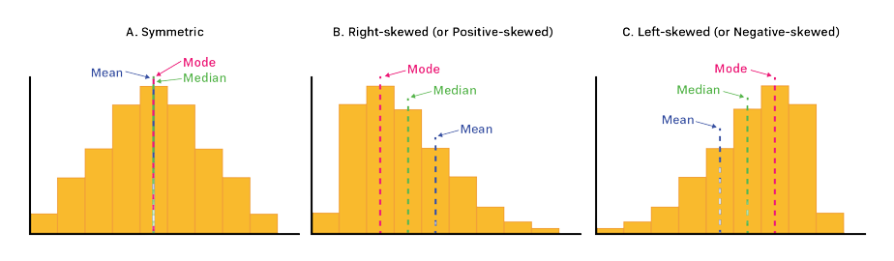

Slide 12
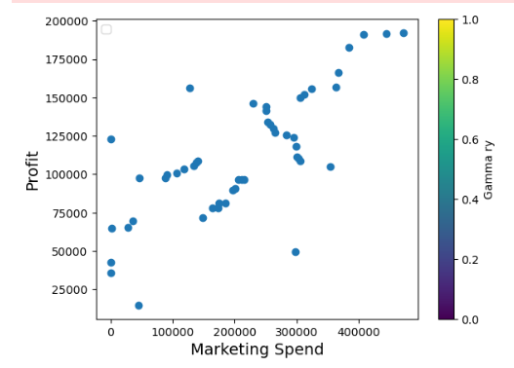
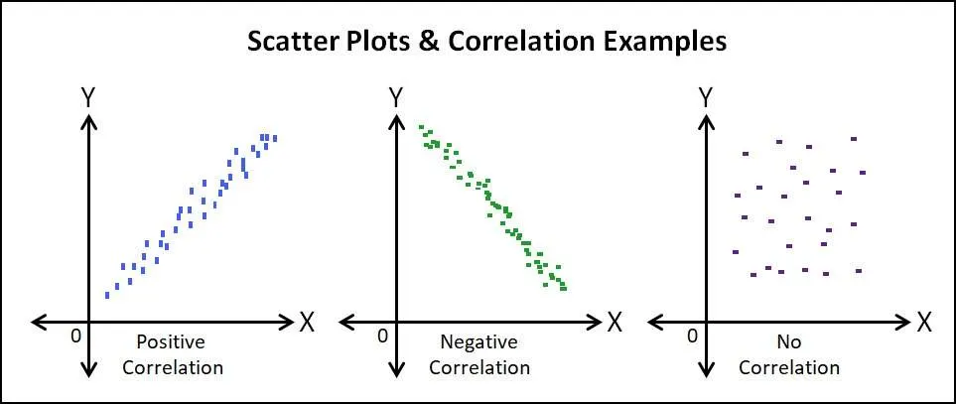
Scatter plot
What is It?
A scatter plot is a type of data visualization that uses points
to represent values for two different variables,
with one variable plotted on the x-axis and the other on the y-axis.
What Does It Visualize?
A scatter plot visualizes the relationship or correlation
between two variables by displaying the distribution and clustering of data points on a two-dimensional graph.
What Does It Measure?
A scatter plot measures the values or measurements of two variables and shows how they are related or interact with each other. It helps to identify patterns, trends, or correlations between the variables.
What Sources of Data Does It Use?
A scatter plot can utilize any type of data source,
such as numerical, categorical, or ordinal data,
to represent the relationship between two variables.

Slide 14
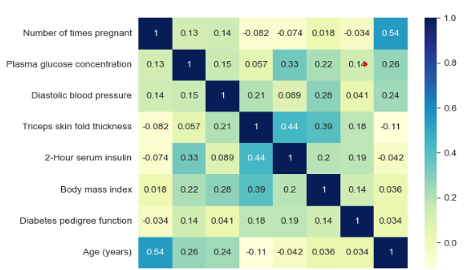
Heatmap
What is It?
A heatmap is a graphical representation
that uses colors to depict the intensity or density of values
within a matrix or grid-like data structure.
What Does It Visualize?
A heatmap visualizes the relative magnitude or distribution of values across two dimensions, typically representing data in a matrix or table format. It highlights patterns, clusters, or variations in the data by using color gradients.
What Does It Measure?
A heatmap measures the intensity, frequency, or density of values within a matrix or grid, providing insight into the distribution or concentration of data across different categories or variables. It allows for the identification of trends, relationships, or patterns within the data.
What Sources of Data Does It Use?
A heatmap can utilize various sources of data, including numerical data, categorical data, or any other type of data that can be represented in a matrix or grid format.

Slide 15
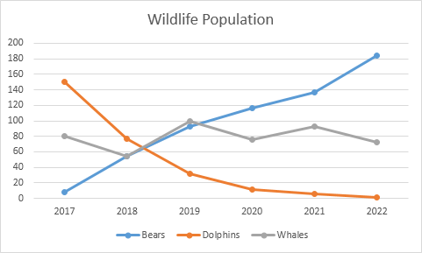
Line plot
What is It?
A line plot is a type of data visualization that represents
the series of data points as connected line segments
to show the trend or change in values over a continuous variable,
typically plotted on the x-axis.
What Does It Visualize?
A line plot visualizes the relationship between two variables by displaying the trend or change in values over a continuous variable, showing the progression or pattern of data points through connected line segments.
What Does It Measure?
A line plot measures the values or measurements of a dependent variable along a continuous axis, how the values of the dependent variable change or vary with respect to the independent variable.
What Sources of Data Does It Use?
A line plot can use various sources of data, including numerical data, time-series data, or any other type of data where there is a continuous variable to be plotted on the x-axis and corresponding values to be plotted on the y-axis.

Slide 16
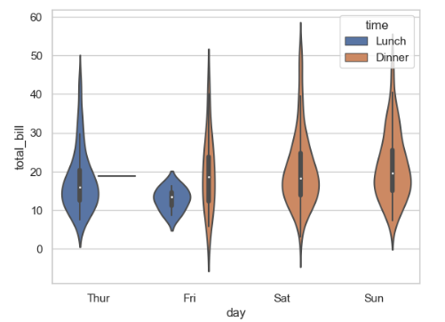
Violin plot
What is It?
A violin plot is a data visualization that combines a box plot and
a kernel density plot to display the distribution of a continuous variable
across different groups, using violin-shaped representations. It provides a concise and
informative summary of the data's distribution and group comparisons.
What Does It Visualize?
A violin plot visualizes the distribution of a continuous variable across different groups or categories, displaying information such as the shape, symmetry, and density of the data, as well as summary statistics like medians and quartiles.
What Does It Measure?
A violin plot does not measure anything directly. Instead, it represents and displays the distribution of a continuous variable, allowing us to observe characteristics such as central tendency, spread, skewness, and multimodality across different groups or categories. It provides a visual representation of the data's distribution and facilitates comparisons between groups.
What Sources of Data Does It Use?
A violin plot uses numerical data, specifically continuous variables, to visualize the distribution across different groups or categories. It requires data that can be quantitatively measured and compared, such as numeric values (temperature, height, weight, time), representing different groups or categories.

Slide 17
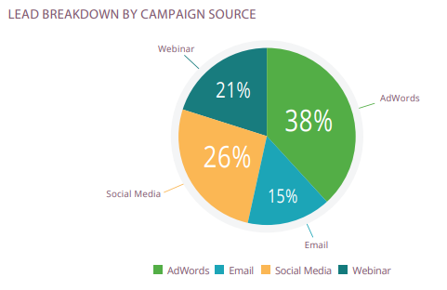
Pie chart
What is It?
A pie chart is a circular graphical representation that divides a dataset into slices or sectors.
Each slice represents a category or proportion of the whole, and the size of the slice
corresponds to the relative magnitude or percentage it represents.
It is commonly used to display the composition or distribution of categorical data.
What Does It Visualize?
A pie chart visualizes the relative proportions or percentages of different categories within a dataset, providing a quick and intuitive understanding of the composition or distribution of the data. It allows for easy comparison of the sizes or contributions of different categories to the whole.
What Does It Measure?
A pie chart measures the relative frequencies, proportions, or percentages of different categories within a dataset. It quantifies the distribution or composition of data and enables comparison of the magnitudes or contributions of each category to the whole.
What Sources of Data Does It Use?
A pie chart can use categorical data or data that can be grouped into distinct categories. It is particularly suitable for visualizing data where the categories and their proportions or frequencies are known. Examples of data sources that can be used for a pie chart include survey responses, market share data, demographic data, or any dataset that can be categorized.

Slide 18
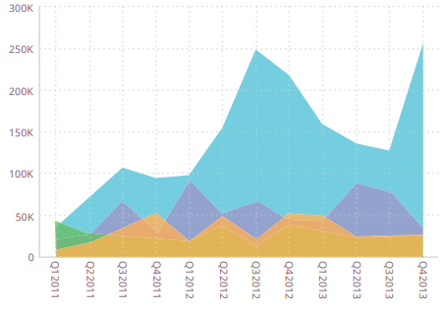
Area chart
What is It?
In the same way that a line chart presents data graphically by connecting each point with a line, an area chart does the same. However, it is more dynamic and visual, providing a sense of relative mass. The region underneath the jagged peaks generated by the line is coloured, giving the impression of a mountain range.
What Does It Visualize?
An area chart visualizes the magnitude and proportion of multiple variables
or categories over a continuous range. It shows how the values of these variables
change over the given range and allows for comparisons between them.
The filled areas between the lines provide a visual representation of the relative
contribution or distribution of each variable or category.
What Does It Measure?
An area chart measures the magnitude and proportion of multiple variables or categories over a continuous range, allowing for visual comparison of their values and distribution patterns. It provides a visual representation of the changing trends and relative contributions of the variables or categories being plotted.
What Sources of Data Does It Use?
An area chart can use various sources of data, including numerical data, time-series data, and categorical data, to visualize the magnitude and proportion of multiple variables or categories over a continuous range.

Slide 19
Box plot
What is It?
A box plot is a statistical visualization that summarizes the distribution of a continuous variable ,It displays the five-number summary
What Does It Visualize?
A box plot visualizes the summary statistics of a continuous variable, such as the minimum, maximum, median, and quartiles. It provides a visual representation of the distribution, spread, and skewness of the data, along with identifying any potential outliers.
What Does It Measure?
A box plot measures the central tendency, variability, and distribution of a continuous variable. It quantifies the minimum, maximum, quartiles, and potential outliers, providing statistical measures to understand the characteristics of the data.
What Sources of Data Does It Use?
A box plot can be used with any dataset that includes numerical or continuous data. It is commonly employed in various fields, including statistics, finance, social sciences, and healthcare. The data can come from experimental studies, survey responses, sensor readings, or any other source that provides quantitative measurements.

Slide 20
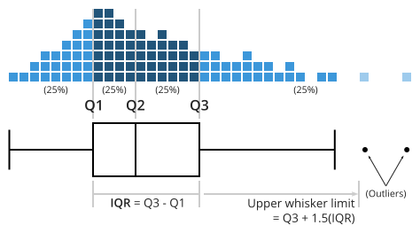
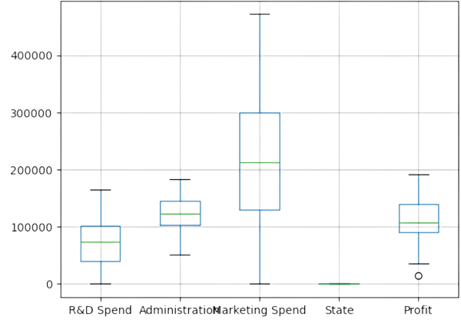
Box plot

Slide 21
Tree map
What is It?
A treemap is a hierarchical visualization that represents hierarchical data using nested rectangles. Each rectangle represents a category, and its size is proportional to a specific value or metric, allowing for visual comparison of the relative magnitudes within the hierarchy. It is often used to display the composition or distribution of data in a space-efficient manner.
What Does It Visualize?
A treemap visualizes hierarchical data by representing categories or groups as nested rectangles, with each rectangle's size reflecting a specific value or metric. It provides a visual representation of the composition and relative proportions within the hierarchy, allowing for easy comparison and understanding of the data distribution.
What Does It Measure?
A treemap measures the relative proportions or magnitudes of different categories or groups within a hierarchical structure. It quantifies the distribution and composition of data based on the sizes of the nested rectangles, providing a visual representation of the hierarchical relationships and the metrics associated with each category or group.
What Sources of Data Does It Use?
A treemap can use hierarchical data from various sources such as organizational structures, file directories, financial portfolios, or any dataset that can be represented in a hierarchical format.

Slide 22
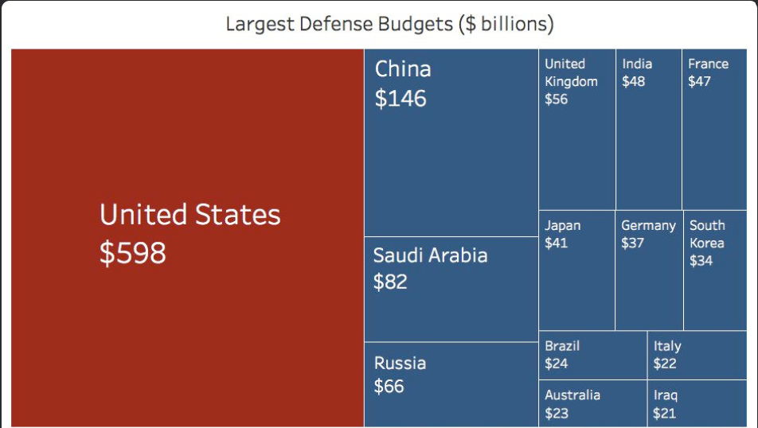

Slide 23
Pivot Table
What is It?
A pivot table brings together, simplifies and summarizes information stored in other tables and spreadsheets, stripping this down to the most pertinent insights. They are also used to create unweighted cross tabulations fast.
What Does It Visualize?
Pivot tables are one of the most simple and useful ways to visualize data. That’s because they allow you to quickly summarize and analyze large amounts of data, and to use additional features such as color formatting and data bars to enhance the visual aspe
What Does It Measure?
Pivot tables are more about simplifying tables than changing it into a graphical representation. That means they are helpful for displaying data with several subcategories in easily digestible ways.
What Sources of Data Does It Use?
A pivot table can use tabular data from various sources such as spreadsheets, databases, or other structured data sources.

Slide 24
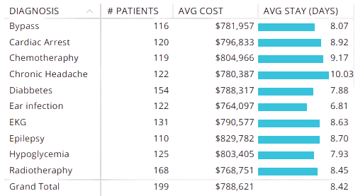
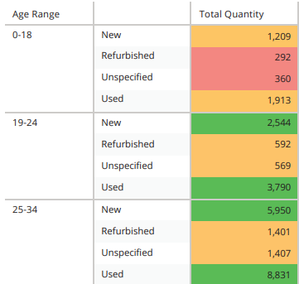

Slide 25
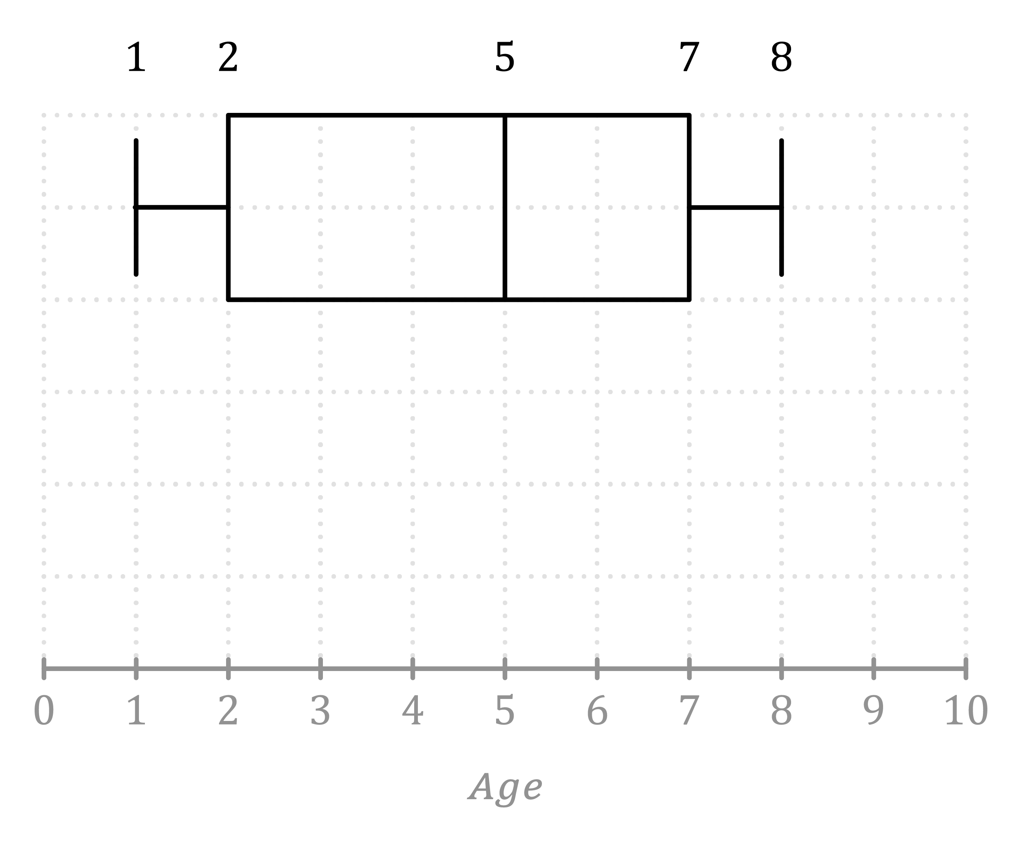
Box plots and whisker plots are great for visualizing the distribution and spread of data. They show the median, quartiles, and outliers, giving you a quick sense of the data's shape. Box plots are especially useful for comparing the distributions of different groups or variables.

Slide 26
THANKS!
Any questions?

